Slide 1
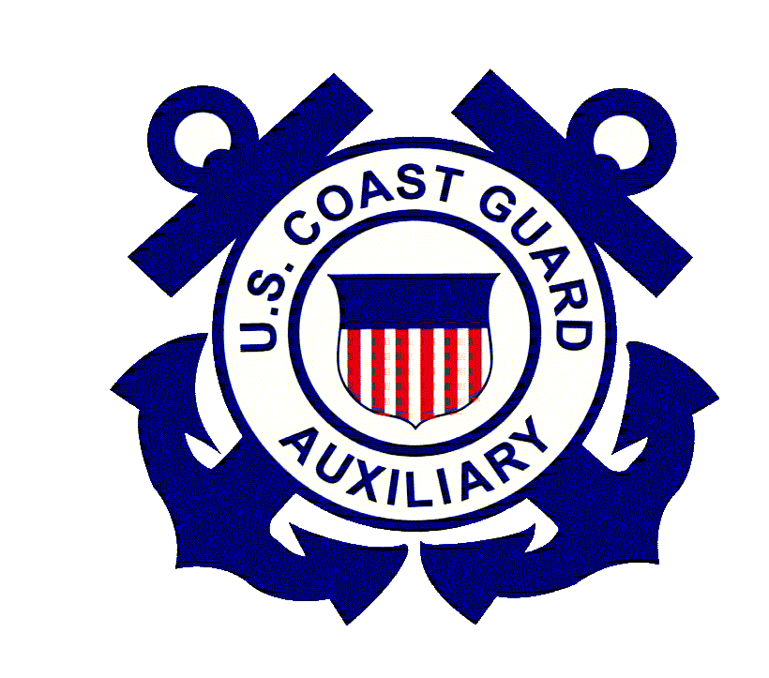
Environment
It is illegal to harass, harm, pursue, wound, kill, capture, or collect any marine mammals (including whales, dolphins, and seals) or endangered species (including sturgeon, salmon, sea turtles, and some whale species)
Prevent violating federal law by:
Giving space to wildlife to reduce the risk of harassment and dangerous collisions.
Going slow to give boaters and animals more time to react

Slide 2
Environment
North Atlantic right whales are endangered and found in coastal waters along the East Coast. Federal law requires vessels, paddle boarders, and aircraft (including drones) to stay at least 1,500 feet (that’s 500 yards = five football fields) away from right whales.
Vessels of certain sizes must go 10 knots or less in seasonal speed-restricted areas. Visit the NOAA Fisheries right whale vessel strike website for information on these areas.

Slide 3
Environment
From Maine to Virginia, keep your boat a safe distance of:
1,500 ft (required by law) from North Atlantic right whales
100 ft (at least!) - 600 ft (is better!) from other whales
150 ft from seals, dolphins, sea turtles, and sturgeon
More information and training on operating safely and responsibly around whales can be found at www.seeaspout.org

Slide 4
Environment
Boaters are urged to report any vessel-struck, entangled, stranded, or dead marine mammal or sea turtle to NOAA Fisheries at (866) 755-6622 or hail the U.S. Coast Guard on VHF radio channel 16.
Search “NOAA sturgeon reporting” for local carcass reporting information online.

